Slide 1
Data Analytics & Visualization
T.E. AI and DS - Jan 2023
Dr. M. Vijayalakshmi

Slide 2
Contents
Text Analysis Steps
A Text Analysis Example
Collecting Raw Text
Representing Text
Term Frequency – Inverse Document Frequency
Categorizing Documents by Topics
Determining Sentiments
Gaining Insights

Slide 3
Text Analysis
Text analysis, or text analytics, concerns the representation, processing, and modeling of text data to derive useful insights
Text mining is the important component of text analysis that discovers the relationships and interesting patterns

Slide 4
The Complexity Of Unstructured Text
7
In general, interpretation / comprehension of unstructured content (text, images, videos) is (often) easy for people, but very complex for computer program
In particular, difficulties with automated text comprehension are caused by the fact that the human / natural language:
is full of ambiguous terms and phrases
often strongly relies on the context and background knowledge for defining and conveying meaning
is full of fuzzy and probabilistic terms and phrases
strongly based on commonsense knowledge and reasoning
is influenced by and is influencing people’s mutual interactions

Slide 5
Additional Challenges Faced By Tm
8
The use of supervised ML methods for TM is often expensive
This is caused by the need to prepare high number of annotated documents to be used as the training dataset
Such a training set is essential for, e.g., document classification or extraction of entities, relations and events
High-dimension of the attribute space:
Documents are often described with numerous attributes, which further impedes the application of ML methods
Dimension – number of distinct words or base forms in corpus
The high dimensionality of text is a major issue
Most often, attributes are either all terms or a selection of terms and/or phrases from the collection of documents to be analyzed

Slide 6
Text Mining Terminology
Unstructured or semistructured data
Corpus (and corpora)-
Terms
Concepts
Stemming
Stop words (and include words)
Synonyms (and polysemes)
Tokenizing

Slide 7
Text Mining Terminology
Term dictionary
Word frequency
Part-of-speech tagging
Morphology
Term-by-document matrix
Occurrence matrix
Singular value decomposition
Latent semantic indexing

Slide 8
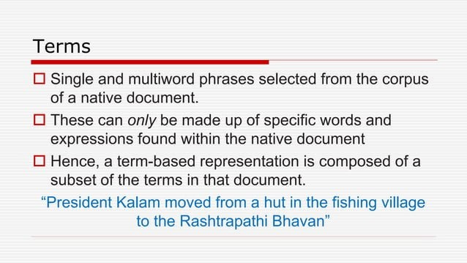

Slide 9
Corpus- Corpora
A corpus is a collection of texts, written or spoken, usually stored in a computer database.
A corpus may be quite small, for example, containing only 50,000 words of text, or very large, containing many millions of words. …
Written texts in corpora might be drawn from books, newspapers, or magazines that have been scanned or downloaded electronically.
Other written corpora might contain works of literature, or all the writings of one author (e.g., William Shakespeare).
Corpus – large collection of texts (plural of corpus is corpora)

Slide 10
Corpus - Examples
Project Gutenberg EBooks, Google Books Ngrams, and arXiv Bulk Data Access.
There are many text corpora from newswire. Examples are 20 Newsgroups and Reuters-
For informal genre, we can include web data and emails. -nCorpora for these include Common Crawl, Blogger Corpus, Wikipedia Links Data, Enron Emails, and UCI's Spambase.
Corpora derived from reviews include Yelp Reviews, Amazon Customer Reviews, and IMDb Movie Reviews.
Even more informal are SMS and tweets, for which we have Sentiment140, Twitter US Airline Sentiment, and SMS Spam Collection.
It's also common to have domain-specific corpora. For example, BioCreative and GENIA are for biology.

Slide 11
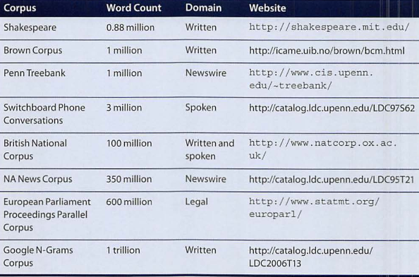
More Examples

Slide 12
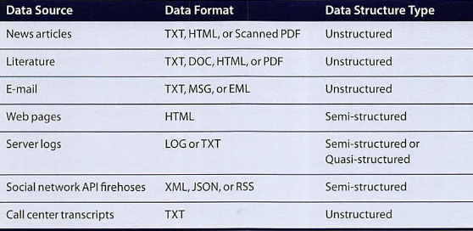
Example Data Sources and Formats for Text Analysis

Slide 13
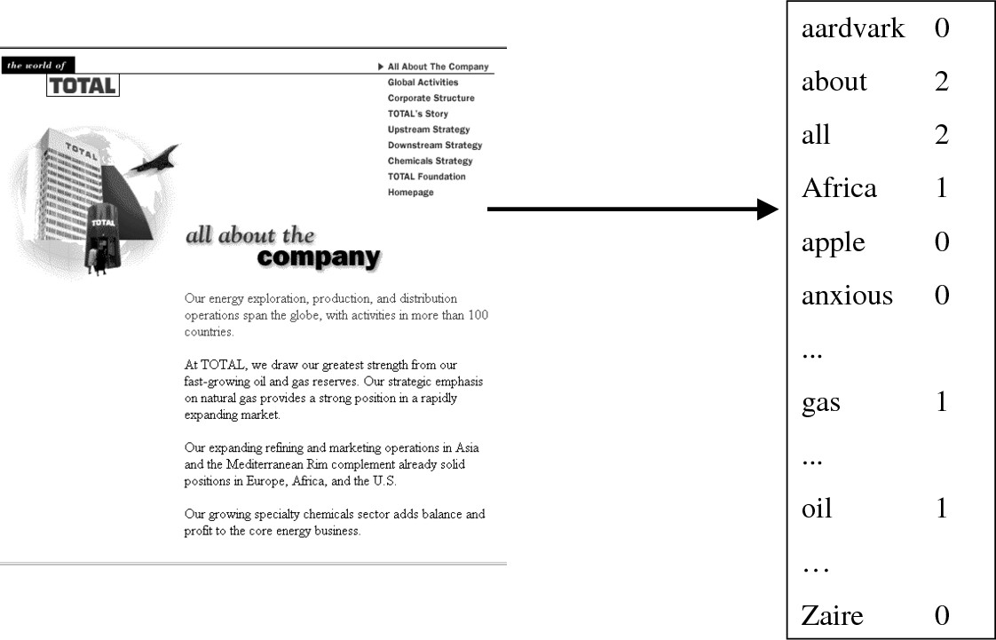
Bag Of Words Representation Of Text
Considers text a simple set/bag of words
Based on the following assumptions:
words are mutually independent,
word order in text is irrelevant
Despite its unrealistic assumptions and simplicity, this approach to text modeling proved to be highly effective,

Slide 14
VECTOR SPACE MODEL
Generalization of the Bag of Words model
Each document from the corpus is represented as a multi- dimensional vector
Each unique term from the corpus represents one dimension of the vector space
Term can be a single word or a sequence of words (phrase)
The number of unique terms in the corpus determines the dimension of the vector space

Slide 15
VECTOR SPACE MODEL
Vector elements are weights associated with individual terms; these weights reflect the relevancy of the corresponding terms in the given corpus
If a corpus consists of n terms (ti, i=1,n), document d from that corpus would be represented with the vector: d = {w1,w2,…,wn }, where wi are weights associated with terms ti
Distances among vectors in this multi-dim. space represent the relationships among the corresponding documents
It is assumed that documents that are ‘close’ to one another in this multi-dim. space, are also ‘close’ (similar) in meaning

Slide 16
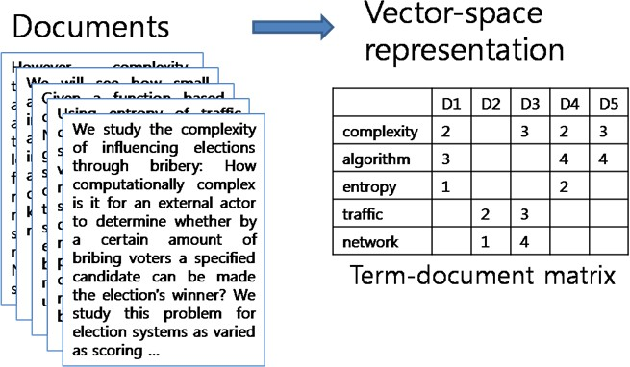
Term Document Matrix
In VSM, corpus is represented in the form of Term Document Matrix (TDM), i.e., an m x n matrix with following features:
Rows (i=1,m) represent terms from the corpus
Columns (j=1,n) represent documents from the corpus
Cell ij stores the weight of the term i in the context of the document j
Image source: http://mlg.postech.ac.kr/research/nmf

Slide 17
Text Preprocessing
Before creating the TDM matrix, documents from the corpus need to be preprocessed
Rationale / objective: to reduce the set of words to those that are expected to be the most relevant for the given corpus
Preprocessing (often) includes:
Normalizing the text
Removing terms with very small / high frequency in the given corpus
Removing the so-called stop-words
Reducing words to their root form through stemming or lemmatization

Slide 18
Normalization Of Text
Objective: transform various forms of the same term into a common, ‘normalized’ form
E.g.: Apple, apple, APPLE -> apple
Intelligent Systems, Intelligent systems, Intelligent-systems
-> intelligent systems
How it is done:
Using simple rules:
Remove all punctuation marks (dots, dashes, commas,…)
Transform all words to lower case
Using a dictionary, such as WordNet, to replace synonyms with a common, often more general, concept
E.g., “automobile, car” -> vehicle

Slide 19
REMOVING HIGH AND LOW FREQUENCY TERMS
Empirical observations (in numerous corpora):
Many low frequency words
Only a few words with high frequency
Formalized in the Zipf’s rule:
the frequency of a word in a given corpus is inversely proportional to its rank in the frequency table (for that corpus)

Slide 20
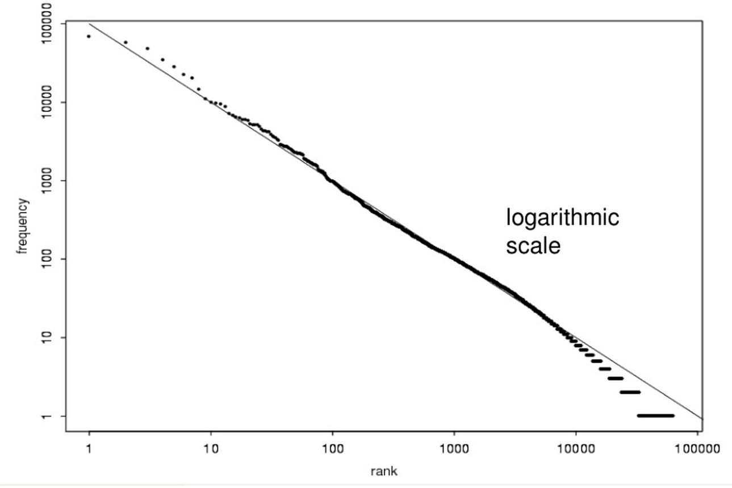
ILLUSTRATION OF THE ZIPF’S RULE
Word frequency in the Brown Corpus of American English text
source: http://nlp.stanford.edu/fsnlp/intro/fsnlp-slides-ch1.pdf

Slide 21
IMPLICATIONS OF THE ZIPF’S RULE
Words in the upper part of the frequency table comprise a significant proportion of all the words in the corpus, but are semantically almost useless
Examples: the, a, an, we, do, to
On the other hand, words towards the bottom of the frequency table are semantically rich, but are of very low frequency
Example: Accessibility, Co location
The rest of the words are those that represent the corpus the best and thus should be included in the VSM model

Slide 22
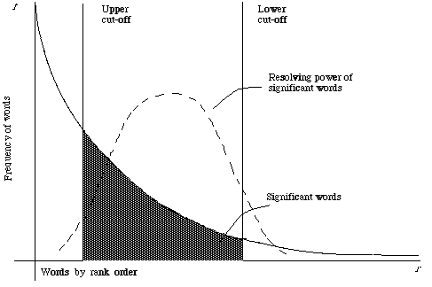
IMPLICATIONS OF THE ZIPF’S RULE
Remove words that do not bear meaning
Remove highly infrequent words
Image source: http://www.dcs.gla.ac.uk/Keith/Chapter.2/Ch.2.html

Slide 23
STOP-WORDS
An alternative or a complementary way to eliminate words that are (most probably) irrelevant for corpus analysis
Stop-words are those words that (on their own) do not bear any information / meaning
It is estimated that they represent 20-30% of words in any corpus
There is no unique stop-words list
Frequently used lists are available at: http://www.ranks.nl/stopwords
Potential problems with stop-words removal:
the loss of original meaning and structure of text
examples: “this is not a good option” -> “option” “to be or not to be” -> null

Slide 24
LEMMATIZATION AND STEMMING
Two approaches to decreasing variability of words by reducing different forms of words to their basic / root form
Stemming is a crude heuristic process that chops off the ends of words without considering linguistic features of the words
E.g., argue, argued, argues, arguing -> argu
Lemmatization refers to the use of a vocabulary and morphological analysis of words, aiming to return the base or dictionary form of a word, which is known as the lemma
E.g., argue, argued, argues, arguing -> argue

Slide 25
VSM: COMPUTING TERMS’ WEIGHTS
There are various approaches for determining the terms’ weights
Simple and frequently used approaches include:
Binary weights
Term Frequency (TF)
Inverse Document Frequency (IDF)
TF-IDF

Slide 26
VSM: BINARY WEIGHTS
Weights take the value of 0 or 1, to reflect the presence (1) or absence (0) of the term in a particular document
Example:
Doc1: Text mining is to identify useful information.
Doc2: Useful information is mined from text.
Doc3: Apple is delicious.
 | text | information | identify | mining | mined | is | useful | to | from | apple | delicious
Doc1 | 1 | 1 | 1 | 1 | 0 | 1 | 1 | 1 | 0 | 0 | 0
Doc2 | 1 | 1 | 0 | 0 | 1 | 1 | 1 | 0 | 1 | 0 | 0
Doc3 | 0 | 0 | 0 | 0 | 0 | 1 | 0 | 0 | 0 | 1 | 1

Slide 27
VSM: TERM FREQUENCY
Term Frequency (TF) represents the frequency of the term in a specific document
The underlying assumption: the higher the term frequency in a document, the more important it is for that document
TF(t) = c(t,d)
c(t,d) – the number of occurrences of the term t in the document d

Slide 28
VSM: INVERSE DOCUMENT FREQUENCY
The underlying idea: assign higher weights to unusual terms, i.e., to terms that are not so common in the corpus
IDF is computed at the corpus level, and thus describes corpus as a whole, not individual documents
It is computed in the following way:
IDF(t) = 1 + log(N/df(t))
N – number of documents in the corpus df(t) – number of documents with the term t

Slide 29
VSM: TF–IDF
The underlying idea: value those terms that are not so common in the corpus (relatively high IDF), but still have same reasonable level of frequency (relatively high TF)
The most frequently used metric for computing term weights in a VSM
General formula for computing TF-IDF:
TF-IDF(t) = TF(t) x IDF(t)
One popular ‘instantiation’ of this formula:
TF-IDF(t) = tf(t) * log(N/df(t))

Slide 30
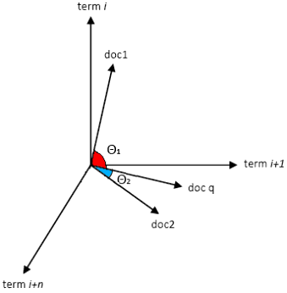
VSM: ESTIMATING SIMILARITY OF DOCUMENTS
Key question: which metric to use for estimating the similarity of documents (i.e., vectors that represent documents)?
The most well known and widely used metric is Cosine similarity

Slide 31
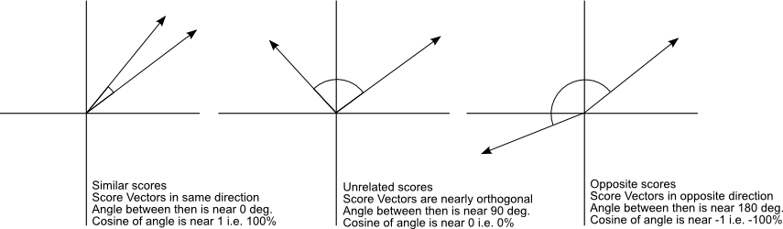
COSINE SIMILARITY
cos(d_{i},d_{j}) = V_{i} x V_{j} / (||V_{i}|| ||V_{j}||)
V_{i} and V_{j} are vectors representing documents d_{i} and d_{j}
Image source: http://blog.christianperone.com/?p=2497

Slide 32
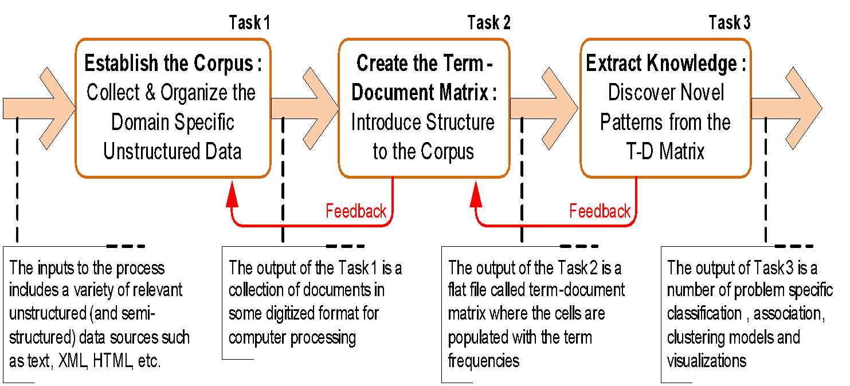
Text Mining Process
The three-step text mining process

Slide 33
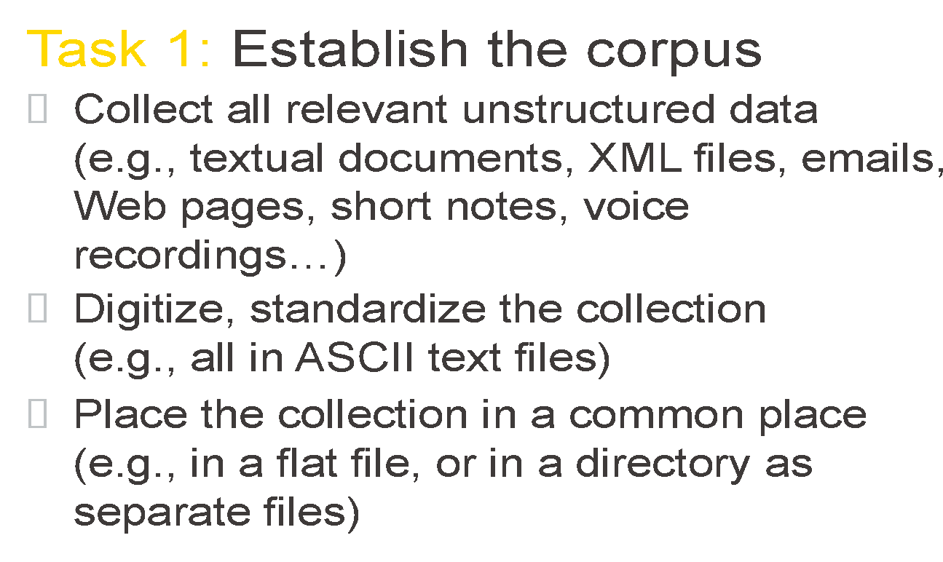
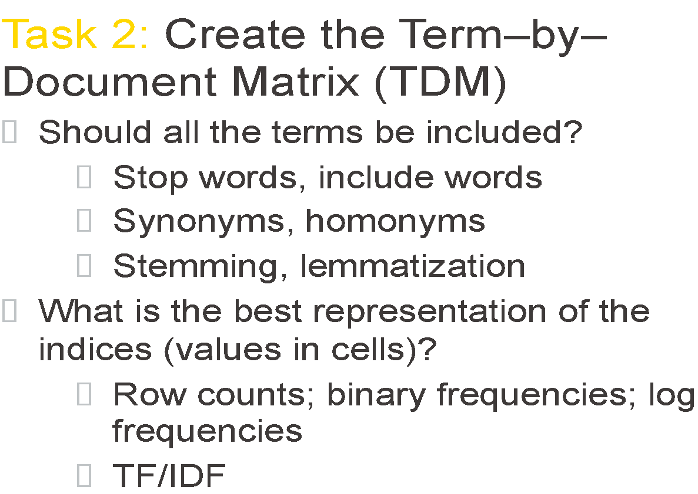
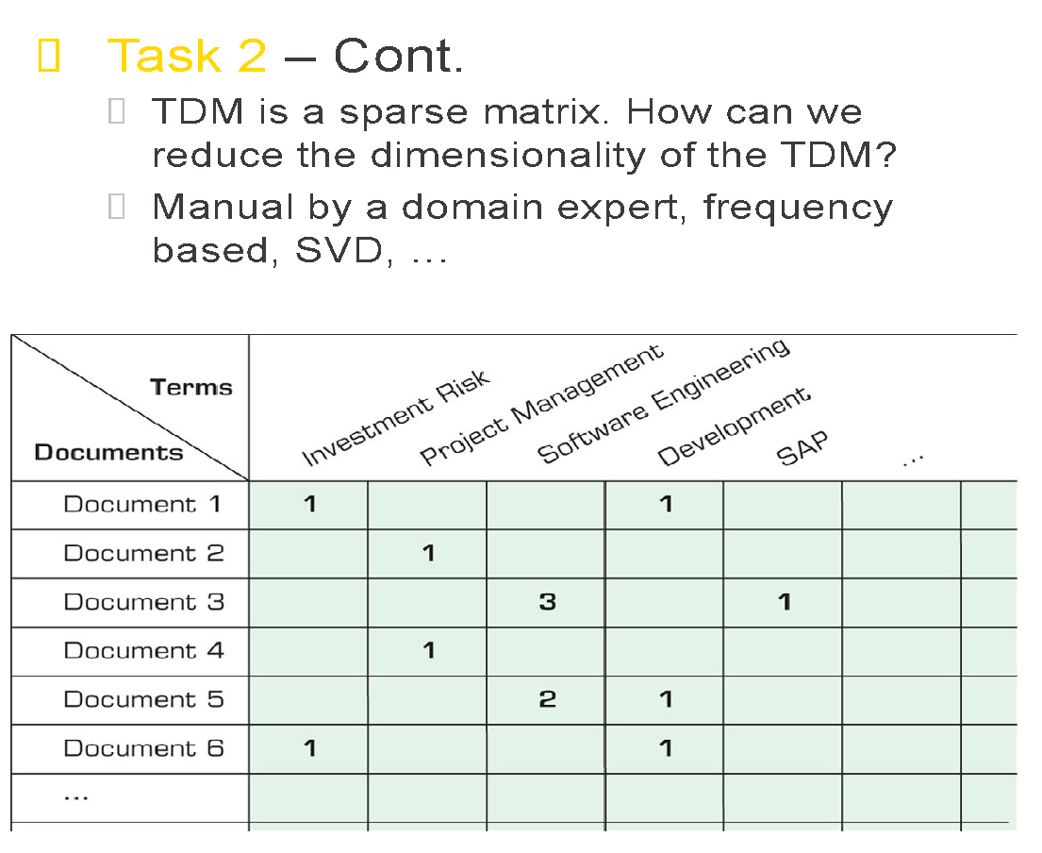
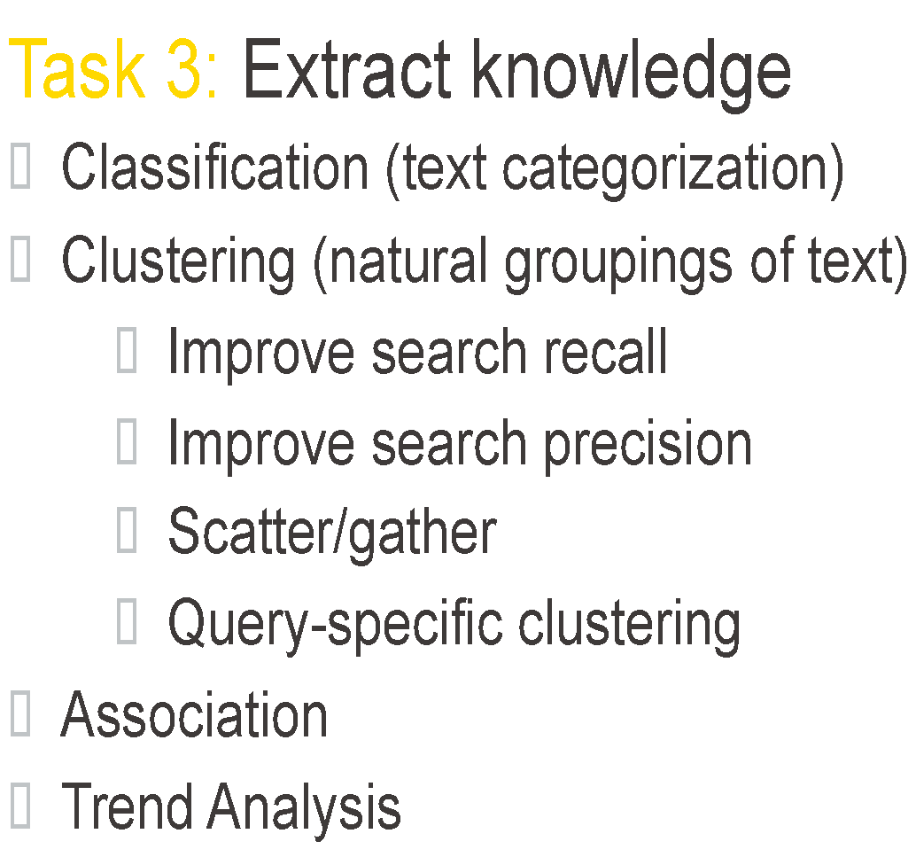

Slide 34
Text Analysis Steps
Parsing
Imposes a structure on the unstructured text
Search and Retrieval
Identifies documents in a corpus that contain search items
Specific words, phrases, topics, entities – e.g., people, organizations
These search items are generally called key terms
Text Mining
Discovers meaningful insights in the text
Uses techniques such as clustering and classification

Slide 35
Part-of-Speech (POS) Tagging, Lemmatization, and Stemming
Part-of-Speech (POS) Tagging
“he saw a fox” => PRP VBD DT NN
pronoun (personal), verb (past tense), determiner, noun (singular)
Lemmatization finds dictionary base forms
obesity causes many problems => obesity cause many problem
Stemming (e.g., Porter’s stemming algorithm)
Similar to lemmatization but dictionary not required
obesity causes many problems => obes caus mani problem

Slide 36
Text Analysis Example
Fictitious company ACME
Makes two products – bPhone and bEbook
ACME monitors social media and popular review sites
Are people mentioning its products?
What is being said?
Are the products seen as good or bad?
If people say ACME product is bad, why?
For example, are they complaining about battery life of the bPhone or response time in their bEbook?

Slide 37
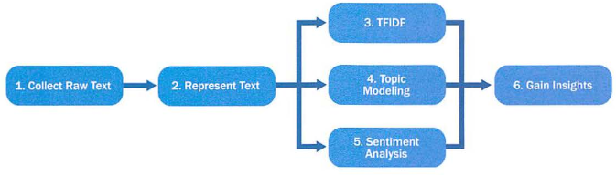
Text Analysis Example
Text Analysis Process

Slide 38
Collecting Raw Data
The text data must first be collected
ACME is interested in what the reviews say about bPhone and bEbook and when the reviews are posted
Many websites and services offer public APIs for third-party developers to access their data
For example, Twitter APIs can retrieve public Twitter posts that contain the keywords bPhone or bEbook

Slide 39
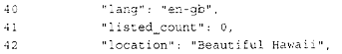
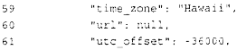
Collecting Raw Data
Example tweet
Line 02: date created
Lines 22-23:
Lines 40-42:
Lines 59-61:

Slide 40
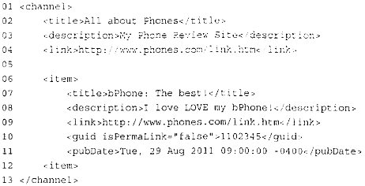
Collecting Raw Data
Example RSS feed for phone review blog

Slide 41
Collecting Raw Data
Use web scraper to extract useful web info
Use the curl tool [ref] to fetch HTML source code given specific URLs
Use Xpath [ref] and regular expressions to select and extract data that matches certain patterns
Regular expressions can find words and strings that match particular patterns of interest

Slide 42
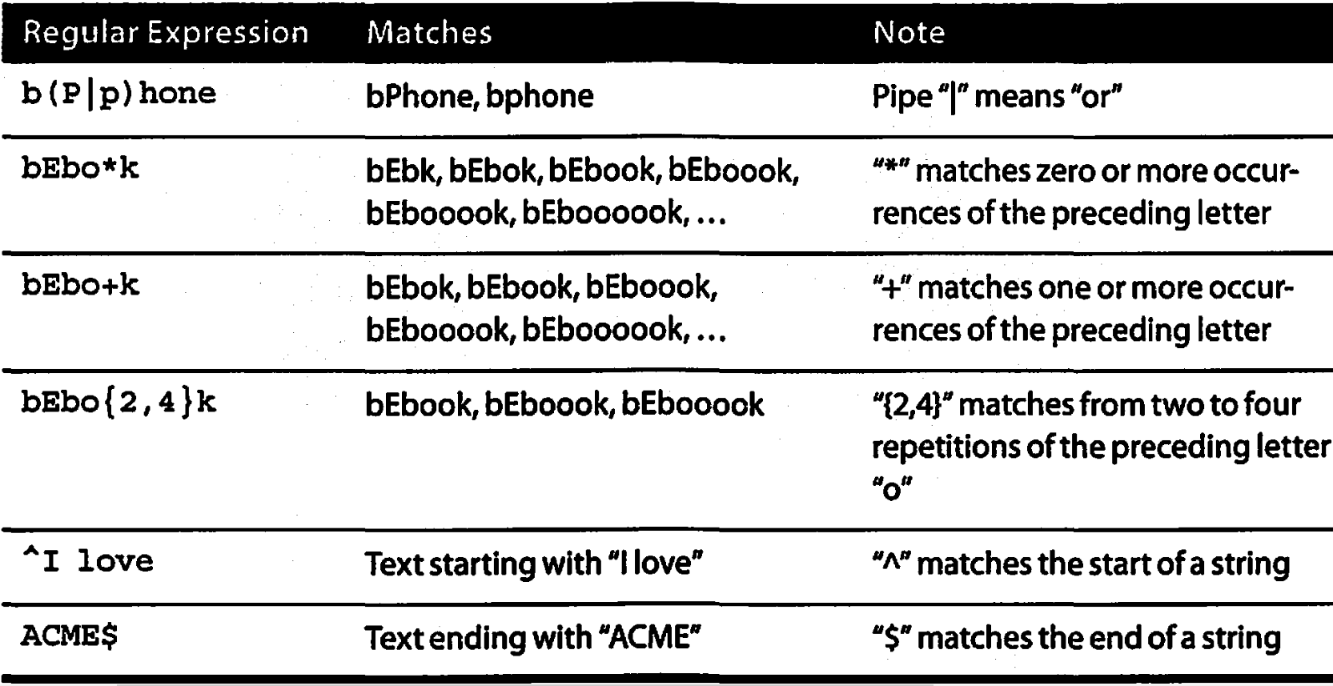
Collecting Raw Data Example Regular Expressions

Slide 43
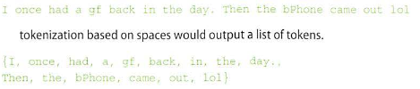
Representing Text
Tokenization – separates words from the text
Case folding – reduces all letters to lowercase
Problems – e.g., WHO = World Health Organization

Slide 44
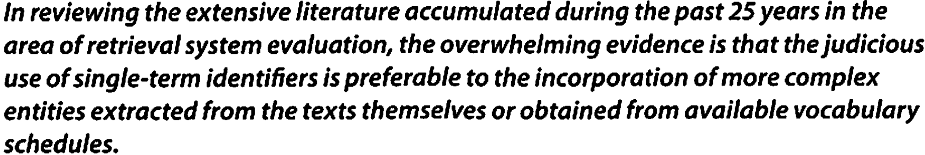
Representing Text
Bag-of-words – represents text as set of terms
Widely-used but naïve approach that eliminates order
“a dog bites a man” is equivalent to “a man bites a dog”
Still considered a good approach

Slide 45
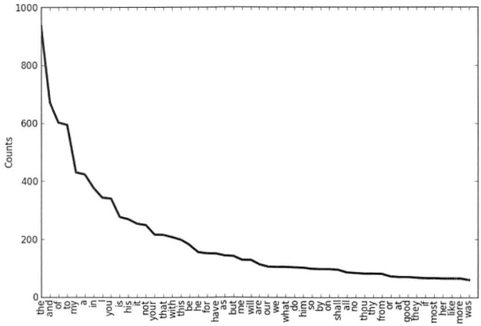
Representing Text
Term frequency (TF) – easily calculated from bag-of-words representation
Roughly follows Zipf’s Law – the frequency of a word is inversely proportional to its rank in the frequency table
50 most frequent words in Shakespeare’s Hamlet

Slide 46
Representing Text
Morphological features – additional info such a POS tag, named entities, etc.
The features are usually designed for a specific task
Creating the features can be a text analysis task in itself
One such example is topic modeling, a method to quickly analyze large volumes of text to identify the topic
Information content (IC) – a metric to denote the importance of a term in a corpus

Slide 47
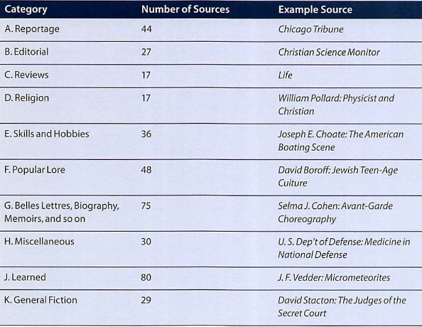
Representing Text Categories of the Brown Corpus

Slide 48
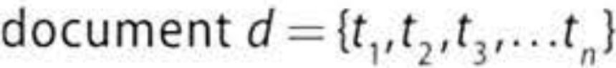
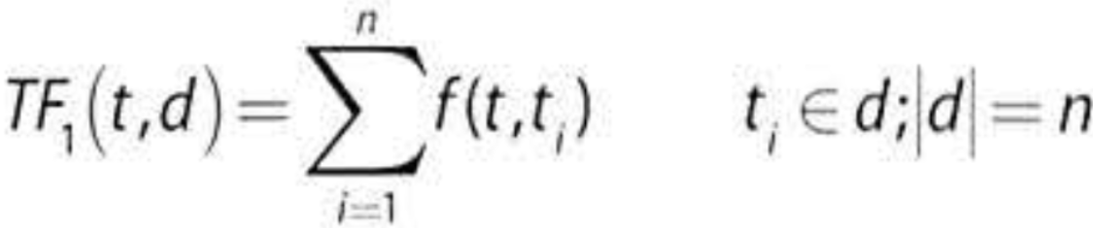
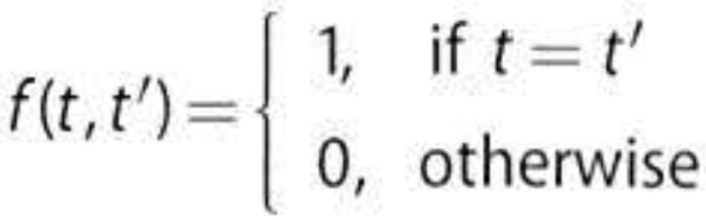
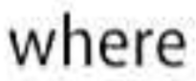
Term Frequency – Inverse Document Frequency (TFIDF)
TFIDF is a widely used measure in text analysis
Term Frequency (TF1): robust, efficient, simplest

Slide 49
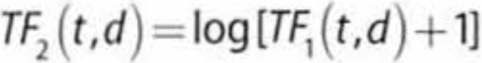
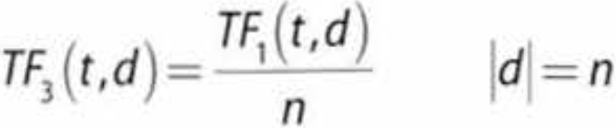
Term Frequency – Inverse Document Frequency (TFIDF)
Other common Term Frequency measures
Log function
Normalized by the length of text document

Slide 50
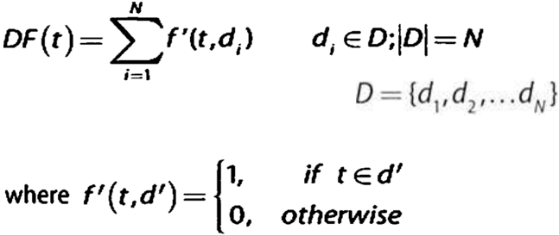
Term Frequency – Inverse Document Frequency (TFIDF)
Term frequency highlights common words
Eliminate stop words, such as the, a, of, and
Also fixing this problem, consider the metrics
Document frequency (DF) = the number of documents in the corpus that contain the term

Slide 51
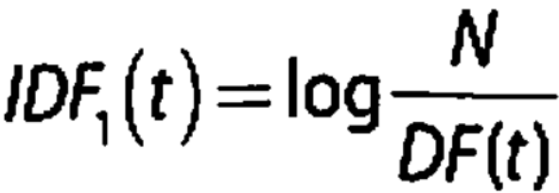
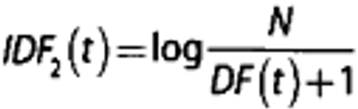
Term Frequency – Inverse Document Frequency (TFIDF)
Inverted document frequency (IDF) is obtained by dividing N by the document frequency
In log form as
Or to avoid division-by-zero as

Slide 52
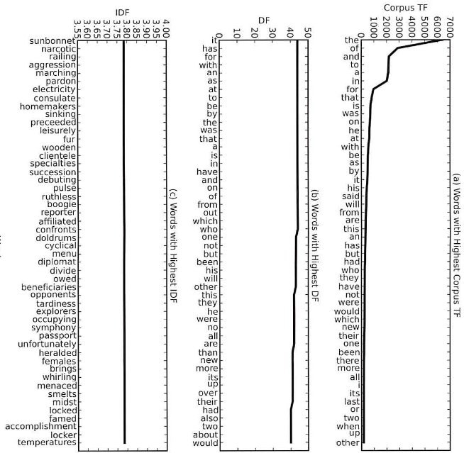
Term Frequency Brown Corpus news category: TF, DF, IDF

Slide 53
Term Frequency – Inverse Document Frequency (TFIDF)
Words with high IDF tend to be more meaningful over the entire corpus
There is still a problem with IDF
Because the document count in a corpus (N) remains constant, IDF depends solely on DF
For example, sunbonnet and narcotic appear same in the previous figure

Slide 54
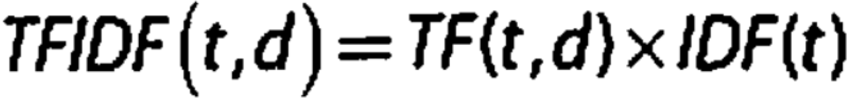
Term Frequency – Inverse Document Frequency (TFIDF)
TFIDF (or TF-IDF) involves both TF and IDF
TFIDF scores words higher that appear more often in a document but less often across all documents
TFIDF applies to a term in a specific document, so it gets different scores in different documents
Reveals little of inter- or intra-document structure

Slide 55
Categorizing Documents by Topics
Returning to the example, the team wants to categorize the reviews by topic
Topic modeling – prevalent statistical approach
Uncovers hidden topical patterns within a corpus
Annotates documents according to these topics
Uses annotations to organize, search, and summarize texts
A topic is formally defined as a distribution over a fixed vocabulary of words

Slide 56
Categorizing Documents by Topics
Latent Dirichlet Allocation (LDA) topic model
Simple generative probabilistic model of a corpus
Data treated as a result of a generative process that includes hidden variables
Assumes fixed vocabulary of words
Assumes constant predefined number of topics

Slide 57
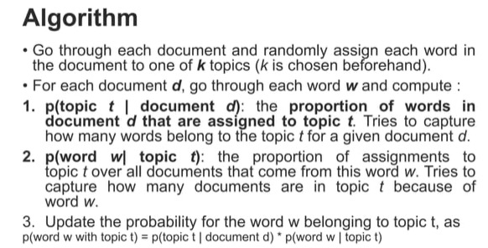

Slide 58
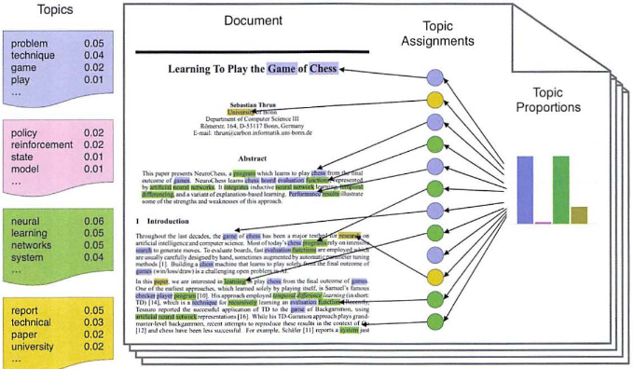
Categorizing Documents by Topics Figure illustrating intuitions behind LDA

Slide 59
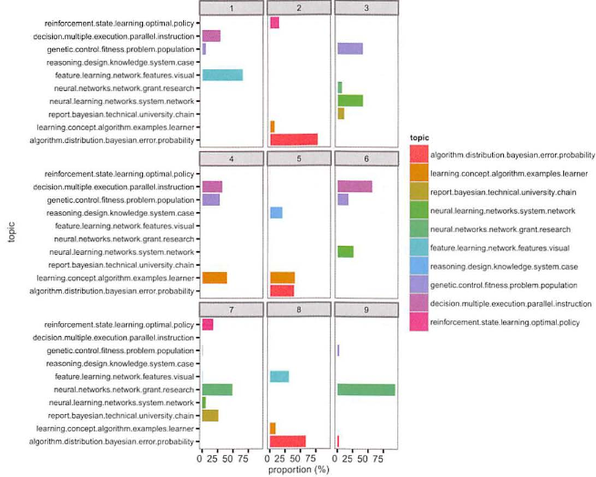
Categorizing Documents by Topics Distribution of ten topics over nine documents

Slide 60
Determining Sentiments
Sentiment analysis is a group of tasks that use statistics and NLP to mine opinions from texts
Make lists of positive and negative words
Positive – brilliant, awesome, spectacular
Negative – awful, stupid, hideous
This simple approach achieves about 60% accuracy
Naïve Bayes, maximum entropy, SVM
Can achieve about 80% accuracy

Slide 61
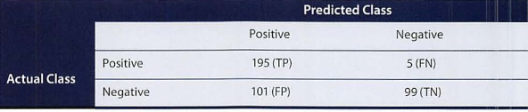
Determining Sentiments Evaluation of prediction models
Data usually split into training and testing sets
Supervised learning – labeled data
Confusion matrix of naïve Bayes example
Performance measures: precision, recall, etc.

Slide 62
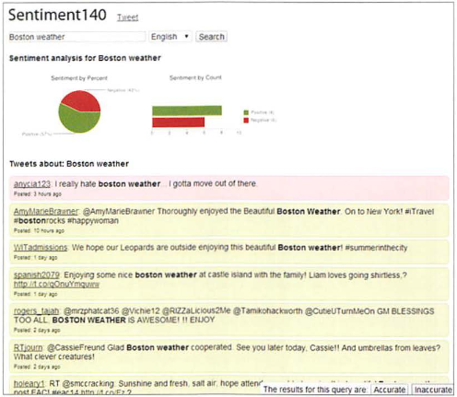
Determining Sentiments Tweet sentiment analysis for Boston weather

Slide 63
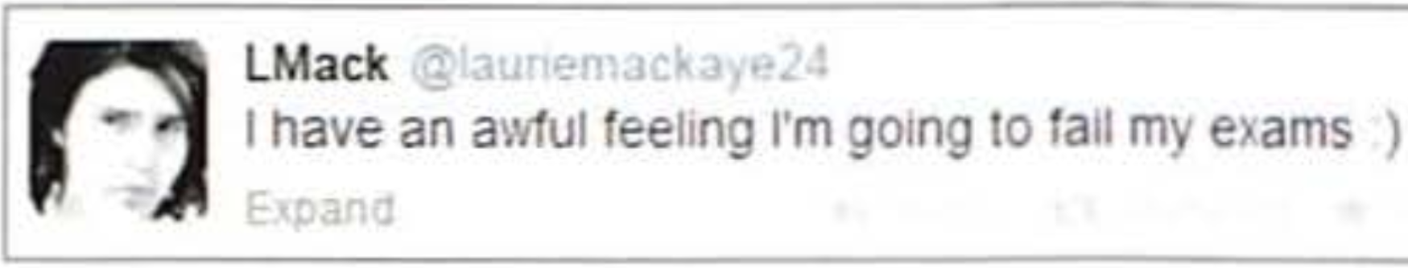
Determining Sentiments
Emoticons can make it easy and fast to detect sentiment but this method can be misleading
E.g., the text below with :) emoticon does not necessarily correspond to a positive sentiment

Slide 64
Determining Sentiments Amazon Mechanical Turk (MTurk)
To address problems mentioned above, Amazon Mechanical Turk (MTurk) can be used
It is a crowdsourcing Internet marketplace that enables individuals or businesses to coordinate the use of human intelligence to perform tasks difficult for computers
MTurk performs Human Intelligence Tasks (HITs)
For example, for the tweets illustrative example, human workers can be asked to tag each tweet as positive, neutral, or negative

Slide 65
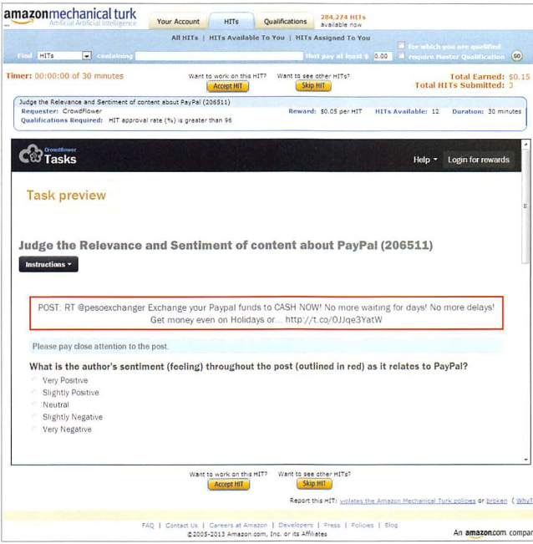
Determining Sentiments Amazon Mechanical Turk (MTurk)

Slide 66
Gaining Insights
Returning to the ACME example we show how various techniques can be used to gain insights into customer opinions
For simplicity, only the bPhone product is used here
The ACME data science team collects 300 reviews
Using the keyword bPhone
After tokenization, removing stop words, and case folding to lowercase, the 300 reviews are visualized as a word cloud with more frequently appearing words in larger font size

Slide 67
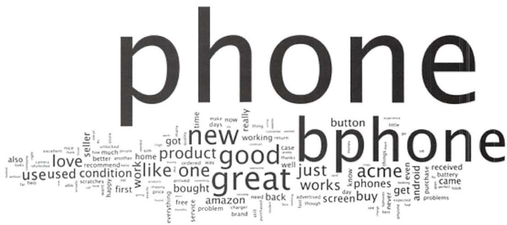
Gaining Insights Word cloud on all 300 bPhone reviews
Often remove domain-specific stop words not useful for the study.
In this case, remove word like phone, bPhone, and ACME.

Slide 68
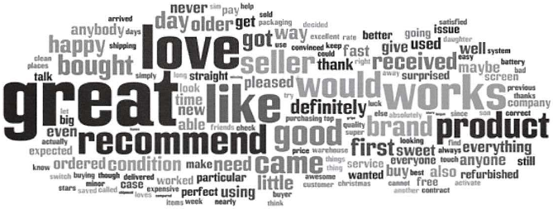
Gaining Insights Word cloud on 50 five-star reviews

Slide 69
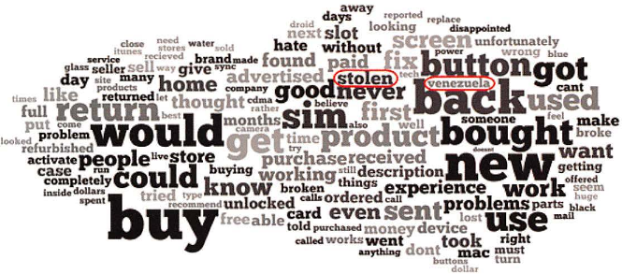
Gaining Insights Word cloud on 70 one-star reviews
Note the words sim, button, stolen, venezuela. Further investigation
revealed unauthorized sellers in Venezuela sold stolen bPhones.

Slide 70
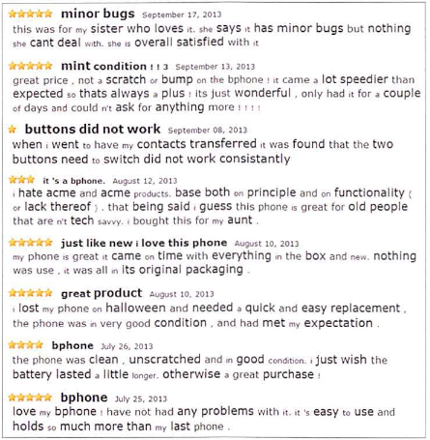
Gaining Insights Reviews highlighted by TFIDF values

Slide 71
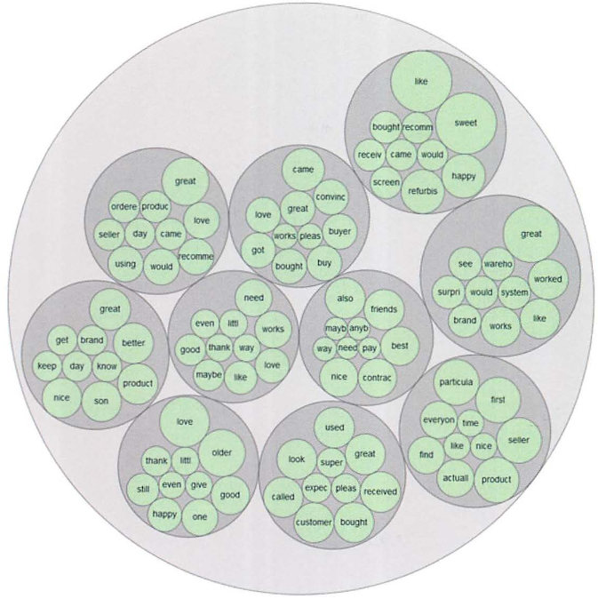
Gaining Insights LDA model: ten topics on five-star reviews
The disc size represents the weight of a word. In an interactive environment, hovering the mouse over a topic displays the full words and their corresponding weights.

Slide 72
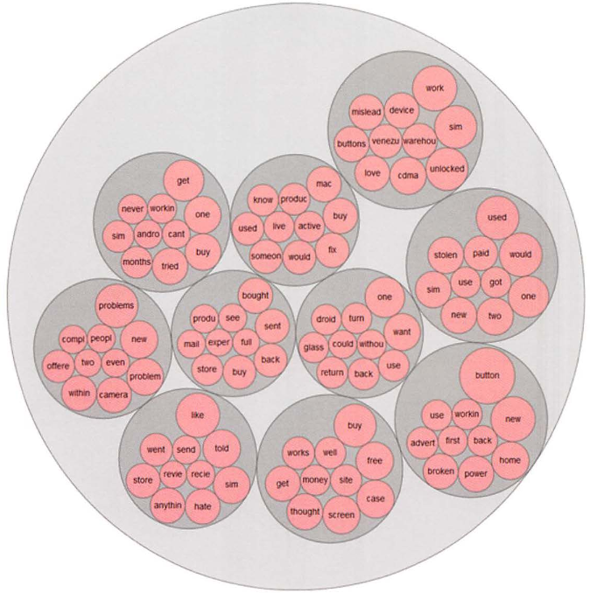
Gaining Insights LDA model: ten topics on one-star reviews

Slide 73
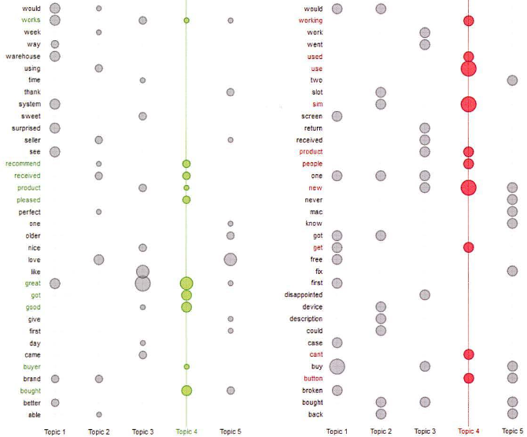
Gaining Insights Five topics: five-star (left) one-star (right)

Slide 74
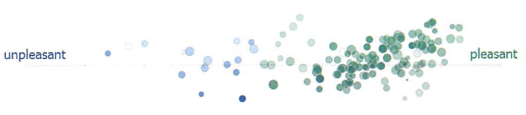
Gaining Insights Sentiment analysis on over 100 tweets
Indicates most customers satisfied with ACME’s bPhone.

Slide 75
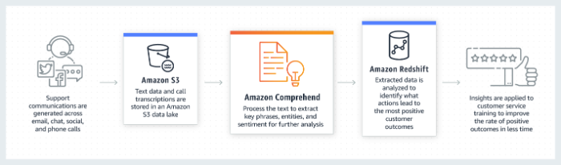
Amazon Comprehend – Gain Insights

Slide 76
Amazon Comprehend - Use Cases
Amazon Comprehend is a natural language processing service that uses machine learning to uncover valuable insights and connections in text.
You can use it to simplify document processing workflows by automatically classifying and extracting information from them.
For example, you can use Amazon Comprehend to do the following tasks:
Perform sentiment analysis on customer support tickets, product reviews, social media feeds, and more.
Integrate Amazon Comprehend with Amazon Lex to develop an intelligent, conversational chatbot.
Extract medical terms from documents and identify the relationship between them with Amazon Comprehend Medical.

Slide 77
Summary
Chapter discussed the subtasks of text analysis:
Parsing
Search and retrieval
Text mining
ACME example used to review the text analysis process
Collecting raw data
Representing text
Using TFIDF to compute the usefulness of each word in the text
Categorizing documents by topics using topic modeling
Sentiment analysis
Gaining greater insights

